Slide 1

WAM Quantization
Progress & Next Steps
Weekly Group Meeting
Guo Yichen 7 October 2026
Notes:
这次汇报分三部分：先确认 Fast-WAM Optional-IDM 的起点和两篇论文的 LIBERO 结果；再看我们自己的 LIBERO-Plus 子集与 A4 诊断；最后说明 action-sensitive weight VQ 的下一步方案。所有论文截图与本地数据分别标注来源。后面的 VQ 架构和 codebook 几何示例是 proposal，不是已完成结果。

Slide 2
Baseline: Fast-WAM Optional-IDM
Stage 1 · Imagine future video
Stage 2 · Infer actions from frozen video
Observation
+ instruction
VideoDiT
video denoising
Frozen video
K / V context
Hold the video branch in BF16 for the first pilot
Proprioception
+ action noise
ActionDiT
action denoising
Action chunk
Transfer after the Fast-WAM pilot: LingBot-VA , Cosmos-Policy
Architecture follows the current Optional-IDM implementation; first VQ pilot targets ActionDiT.
02
Notes:
先用 Fast-WAM 的独立 ActionDiT 做可控、范围小的 weight VQ pilot。当前 Optional-IDM 实现分两段：先 denoise video，然后将完整 denoised video 固定为条件，prefill video K/V，再 denoise action。图按当前实现绘制，不把论文的 first-frame-only 快速路径混入本地 Optional-IDM。第一轮 VQ 只改 ActionDiT，video branch 保留 BF16，并不等同于前面的现有四臂联合 Linear 量化配置。
之后推广到 LingBot-VA 和 Cosmos-Policy；共享 backbone 模型应称 action-targeted，不能假设仍是完全独立的 action-only 模块。
来源：Fast-WAM arXiv:2603.16666v2；本地 FastWAM/src/fastwam/models/wan22/fastwam_idm.py，Stage 1/2 inference implementation。

Slide 3

Fast-WAM on LIBERO: QuantWAMs
Paper-reported result · Table 1
SVDQuant W4A4: 73.7 ± 0.7% LIBERO Avg
QuantWAMs W4A4: 97.4 ± 0.2%
QuantWAMs · arXiv:2607.28405v1 · Table 1, p.7 · Original PDF pixels
03
Notes:
这是 QuantWAMs Table 1 原始截图，Fast-WAM 所在 panel。LIBERO 平均 success：FP16 97.6±0.2%，SVDQuant W4A4 73.7±0.7%，SVDQuant* 75.3±0.6%，Atom 76.2±0.7%，Atom* 82.1±0.5%，QuantWAMs 97.4±0.2%。星号行按论文用于匹配 mixed-precision budget，不能当成与另一篇完全相同的运行 recipe。论文报告 LIBERO 每个 protocol seed 2,000 episodes，3 seeds 合计 6,000；截图中的 ± 是论文报告值。Speedup 与 memory 是该论文的实验口径，不是本地结果。
来源：QuantWAMs: Calibrating at the Right Granularity for World Action Models, arXiv:2607.28405v1, Table 1, PDF physical p.7。https://arxiv.org/abs/2607.28405v1

Slide 4
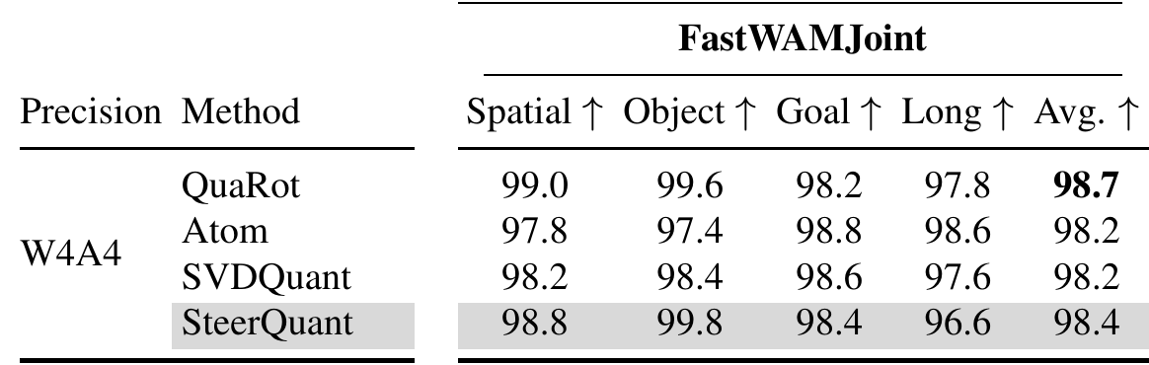
Fast-WAM on LIBERO: SteerQuant
Paper-reported result · FastWAMJoint W4A4 rows, Table 1
SVDQuant W4A4: 98.2% here vs 73.7% in QuantWAMs
Check model variant, quantization scope and evaluation protocol.
SteerQuant · arXiv:2609.39056v1 · Table 1, p.7 · Same-page pixel zoom
04
Notes:
这是 SteerQuant Table 1 的 FastWAMJoint 部分，保留原 PDF pixels。为了可读性，zoom 从同一页拼接左侧 Precision/Method 与右侧 FastWAMJoint panel，聚焦 header 与 W4A4 rows，没有改写数字。红圈标出 SVDQuant W4A4 的 Avg 98.2%。上一页 QuantWAMs 同名 baseline 是 73.7±0.7%，mean 相差 24.5 个百分点；Atom 也存在较大差异。现阶段把它作为 cross-paper protocol alignment 问题，不能仅凭两个表宣称论文或数据有误。需要先对齐模型变体 / checkpoint、量化范围、calibration、mixed precision 和 evaluation seeds。SteerQuant caption 报告 2,000 LIBERO rollouts。
来源：SteerQuant: Steering Quantization Error with Action-Guided Scaling in World-Action Models, arXiv:2609.39056v1, Table 1, PDF physical p.7。https://arxiv.org/abs/2609.39056v1

Slide 5
Our LIBERO-Plus pilot: observed subset
300 paired variants · Libero Spatial only · 6 of 28 planned cells
Spatial dimension | BF16 | W4A8 | W4A4 | W4A4KV4
Background textures (n=50) | 44/50 (88%) | 45/50 (90%) | 0/50 (0%) | 0/50 (0%)
Camera viewpoints (n=50) | 26/50 (52%) | 26/50 (52%) | 0/50 (0%) | 0/50 (0%)
Language instructions (n=50) | 46/50 (92%) | 46/50 (92%) | 0/50 (0%) | 0/50 (0%)
Light conditions (n=50) | 47/50 (94%) | 48/50 (96%) | 0/50 (0%) | 0/50 (0%)
Objects layout (n=50) | 47/50 (94%) | 47/50 (94%) | 0/50 (0%) | 0/50 (0%)
Robot initial states (n=50) | 33/50 (66%) | 40/50 (80%) | 0/50 (0%) | 0/50 (0%)
Overall (n=300) | 243/300 (81%) | 252/300 (84%) | 0/300 (0%) | 0/300 (0%)
W4A8: +3 pp descriptively; both A4 arms: 0/300.
Local snapshot: 6 Oct 2026 · All completed shards · Joint Linear quantization · 22 cells have no results
05
Notes:
这是用户本地 frozen-checkpoint Fast-WAM Optional-IDM LIBERO-Plus 四臂闭环测量，不是 paper-reported 数值。预注册计划是 4 suites × 7 dimensions，每格 n=50，共 1,400 variants、5,600 arm episodes。最新 all-completed 聚合覆盖 78 个保留 shards、300 个 paired Spatial variants 和 1,200 个 arm episodes。总表分母每臂都是 300：BF16 243/300 (81%)，W4A8 252/300 (84%)，W4A4 与 W4A4KV4 各 0/300；两个 W4A4 臂的已完成 episode 都以 400-step control_step_timeout 结束。W4A8 对 BF16 的配对差为 +3.0 个百分点（19 个仅 W4A8 成功、10 个仅 BF16 成功）。逐维表只放有数据的 6 个 libero_spatial dimension，每格 n=50；其他 22 个 cell 在当前聚合中缺失，不要补成 0。12 个已取消 children（indices 78–89）从聚合排除。结论仅限该 observed subset，不说完整 Plus 或“所有 A4”均失败。W4A4KV4是 W4+A4+KV4 组合，没有 BF16KV4 arm，不能独立归因 KV4。
现有四臂使用相同 W4 G128 weight bank 与 dynamic per-row RTN A8/A4，量化614个Linear（video/action/proprio），不是前页拟议的 ActionDiT-only VQ。Text/VAE、norm、非Linear和attention运算保持BF16。没有完整benchmark结论，也没有正式部署latency。
本地来源：D:/Downloads/Final Year Project/experiment/idea-validation/fastwam-libero-plus-pilot/artifacts/25699421.pbs101/results/analysis.json

Slide 6
A4 diagnosis: error appears before rollout
300 reset-observation pairs
Activation encoding: A4 vs A8
Median normalized motor RMSE
First 10 action positions
Zero-code ratio and input relative RMSE
Call region | A4 zero codes | A8 zero codes | A4 rel. RMSE | A8 rel. RMSE
Video prefill | 71.52% | 8.52% | 41.54% | 2.97%
Video step 0 | 69.37% | 8.45% | 38.69% | 2.88%
Video step 9 | 65.39% | 7.97% | 37.39% | 2.79%
Action step 0 | 55.98% | 6.07% | 31.49% | 2.03%
Action step 9 | 58.77% | 6.32% | 31.49% | 1.97%
Proprio | 13.64% | 0.57% | 6.50% | 0.33%
Comparison | RMSE
W4A8 vs BF16 | 0.0228
W4A4 vs BF16 | 0.3222
W4A4KV4 vs BF16 | 0.3217
KV4 addition vs W4A4 | 0.0387
High A4 zero-code ratios accompany larger input RMSE in these calls.
Right: user-provided activation diagnostic. Step 0/9 denotes denoising iterations.
06
Notes:
左侧保留原 n=300 paired reset-observation action-output evidence，motor RMSE 是前10个action位置的 median normalized RMSE。右侧按照用户提供的截图逐值转录，表中量化调用区域分别为 Video conditioning prefill、Video denoising step 0/9、Action denoising step 0/9、Proprio conditioning。所有百分比与截图保持一致；缩短行名只为版面，step 0/9 是 diffusion denoising iterations，与左侧动作块前10位置不同。零编码比例是量化为zero code的比例，不能直接等同于整个输入张量都为零。输入relative RMSE是截图中的activation/input指标，不能与左侧action-output RMSE混为一个指标或假定同一分母。截图没有给样本数、聚合范围或reference细节，因此不补造这些定义，也不将右侧标成 n=300。观察是这些调用中A4的zero-code ratio与input error都明显大于A8，支持进一步检验activation quantizer的动态范围和尺度分配。
右表来源：用户截图 D:/Downloads/Final Year Project/Weekly Slides/2026-10-07_Figure_Designs/activation-diagnostic-reference.png。左表来源：experiment/idea-validation/fastwam-libero-plus-pilot/artifacts/25699421.pbs101/results/analysis.json#/supplementary/first_action。

Slide 7
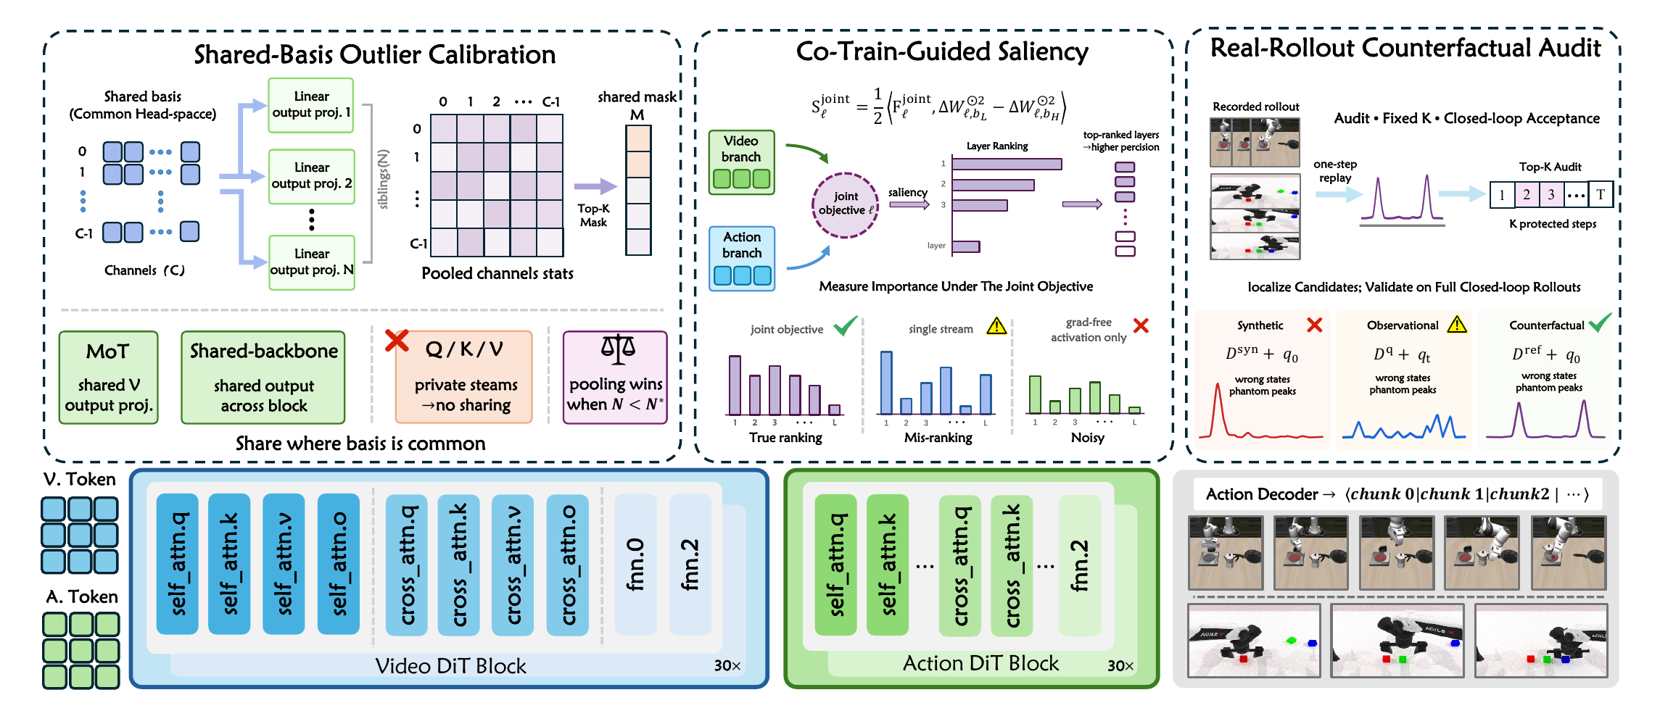
QuantWAMs: calibrate at the right granularity
Structure-aware calibration + joint saliency + rollout validation
QuantWAMs · arXiv:2607.28405v1 · Figure 2 · Figure crop from original PDF
07
Notes:
主要 figure 是 QuantWAMs Figure 2 原图。可按左中右说明：shared-basis calibration 只在 coordinate-compatible modules 合并activation statistics，不能随意把Q/K/V跨private streams合并；co-training-guided saliency 用joint video-action objective排序层，配置mixed precision；real-rollout counterfactual audit 用固定干预对denoising-step protection做closed-loop验证。启发是：量化误差的重要性要按系统结构与控制结果判断，不能只用activation amplitude。
来源：QuantWAMs, arXiv:2607.28405v1, Figure 2。https://arxiv.org/abs/2607.28405v1

Slide 8
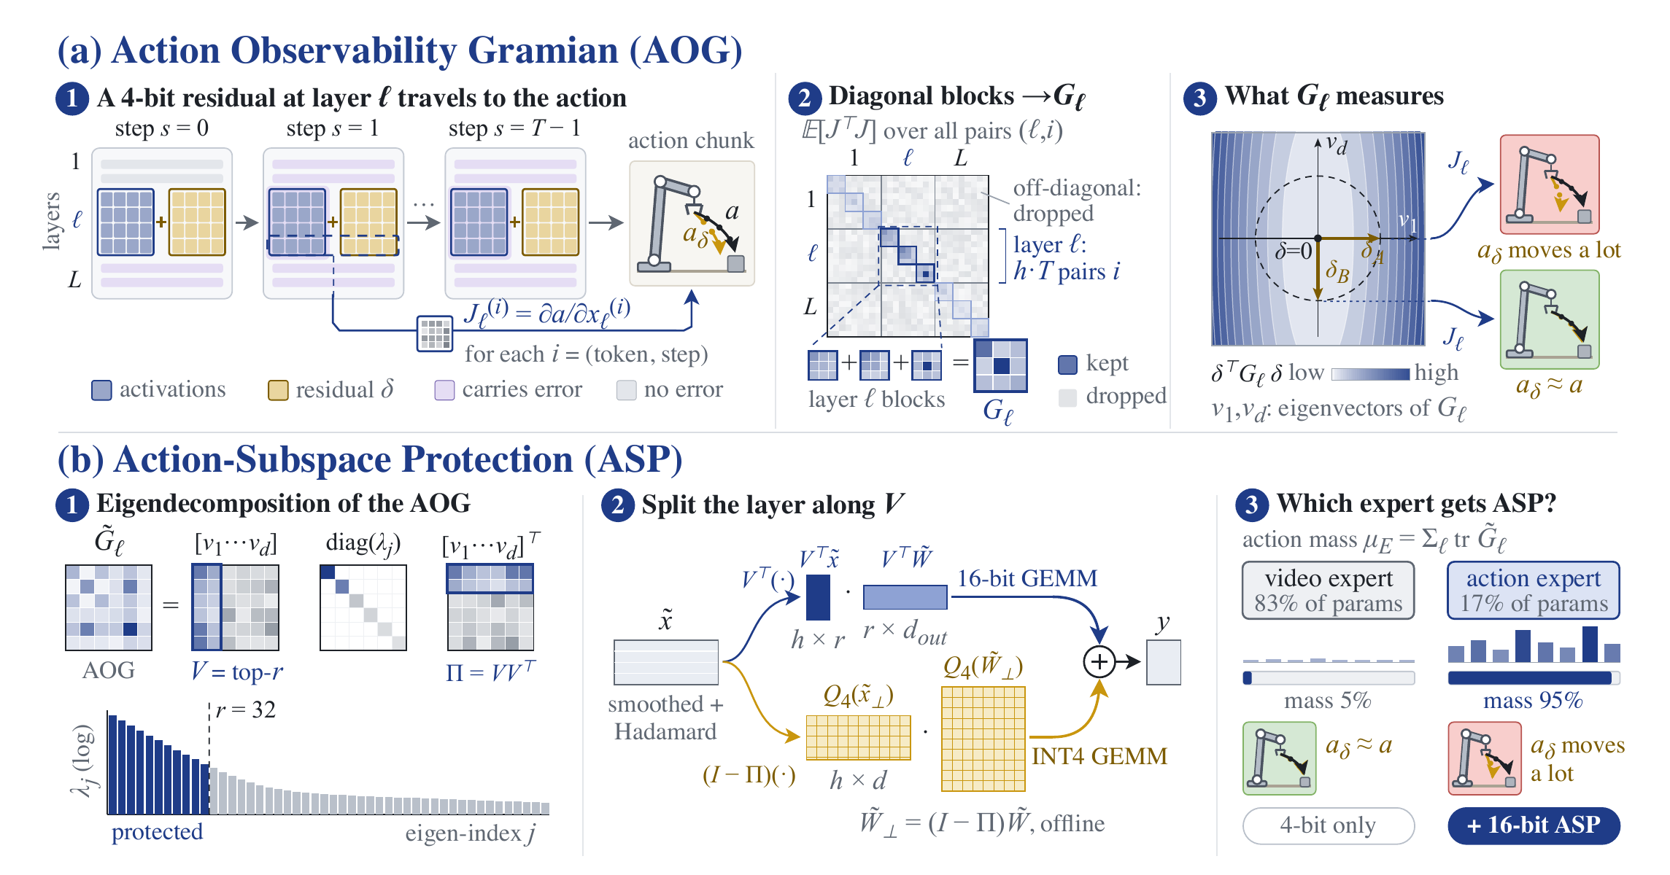
Q-WAM: protect action-sensitive subspaces
Measure action sensitivity; preserve the most influential directions.
Q-WAM · arXiv:2609.33269v1 · Figure 2 · Figure crop from original PDF
08
Notes:
Q-WAM Figure 2 原图。AOG（Action Observability Gramian）估计layer输入误差经过后续denoising传播到最终action的敏感方向；ASP把最敏感子空间留在16-bit branch，剩余部分4-bit。图中的95% action mass/17% action-expert parameters是论文对应设置下的统计，不是所有WAM通用常数。其benchmark主要是RoboTwin与real-world，不把这篇列成Fast-WAM LIBERO表的来源。
对于我们的VQ方案，action sensitivity已有先例，不能把“关注action敏感方向”单独视作novelty。下一步要验证敏感度是否能指导weight codebook，而不是机械复制一个高精度残差branch。
来源：Q-WAM: 4-Bit Quantization of World Action Models with Action-Subspace Protection, arXiv:2609.33269v1, Figure 2。https://arxiv.org/abs/2609.33269v1

Slide 9
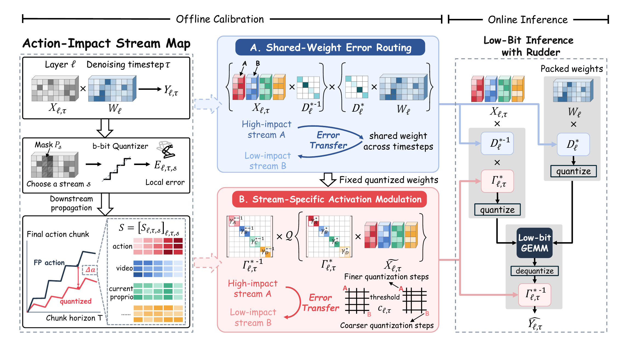
SteerQuant: route error away from actions
Action-impact calibration → error routing → fused low-bit inference
SteerQuant · arXiv:2609.39056v1 · Figure 2 · Figure crop from original PDF
09
Notes:
SteerQuant Figure 2 原图。先估计layer × denoising timestep × stream的action-impact map，再用shared-weight scaling与stream-specific activation modulation把量化误差转移到较低action-impact的stream。Online inference 的 Rudder 把 scaling、量化/反量化或output compensation与low-bit GEMM融合。它不是已实现的VQ lookup kernel，后续我们若做VQ需要设计codebook/index表示和lookup/decode/GEMM的路径。
来源：SteerQuant: Steering Quantization Error with Action-Guided Scaling in World-Action Models, arXiv:2609.39056v1, Figure 2。https://arxiv.org/abs/2609.39056v1

Slide 10
Next step: action-sensitive weight VQ
(a) Equivalent conditioning
(b) Action-sensitive weight VQ
(c) Action inference
Reparameterize activations and weights (no change before quantization)
Quantize transformed weights with an action-aware metric
Quantized weights for low-bit inference
Activations X ∈ ℝᵀˣᵈ
Conditioned activations
Row-wise vector quantization (per output row)
outlier
channels
X′ ∈ ℝᵀˣᵈ
wᵢ′ ∈ ℝ¹ˣᵈ
Quantized activations X′
Quantized weights Ŵ′
⋯
Anisotropic metric M
BF16 for first pilot
A8 / A4 later
v₂
T (tokens)
⋯
Scale + Hadamard
⋯
block 1
block 2
block K
M
X′ = XD⁻¹H
T
Split each row into K small vectors
T
⋯
n
⋯
Sensitive codebook C + vector indices z
v₁
d
d
d (channels)
d
C ∈ ℝⱽˣᵐ
index z
Weights W ∈ ℝⁿˣᵈ
Transformed weights
w ∈ ℝ¹ˣᵐ
3
Sensitivity-guided
assignments
Linear
arg_{z} min
1
W′ ∈ ℝⁿˣᵈ
(w−c_{z})ᵀM(w−c_{z})
⋯
⋮
Y = X′Ŵ′ᵀ
Paired transform
7
n (output dim)
W′ = WDH
n
⋯
codebook (V × m)
Action chunk Y ∈ ℝᵀˣⁿ
d
Action sensitivity M ∈ ℝᵐˣᵐ
Reconstruct quantized weights
⋯
d (input dim)
Ŵ′ ∈ ℝⁿˣᵈ
T
(estimated from calibration)
⋯
X′W′ᵀ = XWᵀ when HHᵀ = I and D is invertible.
n
Row-vector convention: Y = XWᵀ.
Calibration feedback (offline)
Measure final-action sensitivity
Measure action sensitivity from final actions and update M, C
(e.g., ∂a/∂x, rollout-based)
10
Notes:
Row-vector convention: Y=XWᵀ. With D invertible and HHᵀ=I, X′=XD⁻¹H and W′=WDH preserve the unquantized linear output. The displayed Linear output is an intermediate feature unless the remaining ActionDiT/denoising steps are also included. Final-action sensitivity must propagate through those steps.
Figure source: D:\Downloads\Final Year Project\Weekly Slides\2026-10-07_Figure_Designs\imagegen-method-reference.png.

Slide 11
Next step: action-sensitive weight VQ
(a) Euclidean assignment (L₂)
(b) Action-weighted assignment
(c) Metric and codebook geometry
Nearest in Euclidean distance
Nearest under action-sensitive metric
Less sensitive
(direction 2)
Less sensitive
(direction 2)
Action-weighted distortion
dₘ(v, c) = (v − c)ᵀM(v − c)
c₂ = (0, 0.6)
c₂ = (0, 0.6)
0.6
0.6
9 0
0 1
higher penalty
(more sensitive)
‖v − w‖₂ = 0.6
(v − w)ᵀM(v − w) = 0.36
M =
0.3
0.3
lower penalty
(less sensitive)
0
c₁ = (0.3, 0)
0
c₁ = (0.3, 0)
Codebook geometry (equal action error)
w = (0, 0)
w = (0, 0)
central codeword w
−0.3
−0.3
other codewords c
−0.6
More sensitive
(direction 1)
−0.6
More sensitive
(direction 1)
(v − w)ᵀM(v − w) = const.
(vertical-to-horizontal
radius ratio = 3)
−0.6
−0.3
0
0.3
0.6
−0.6
−0.3
0
0.3
0.6
Euclidean squared distances
Action-weighted squared distances (M = diag(9, 1))
The action-sensitive metric allocates finer
codebook resolution along the more sensitive
direction (horizontal) and coarser resolution
along the less sensitive direction (vertical).
d₂(w, c₁) = ‖w − c₁‖₂² = 0.09
L₂ chooses
dₘ(w, c₁) = (w − c₁)ᵀM(w − c₁) = 0.81
Action-aware
VQ chooses
d₂(w, c₂) = ‖w − c₂‖₂² = 0.36
c₁
dₘ(w, c₂) = (w − c₂)ᵀM(w − c₂) = 0.36
c₂
11
Notes:
Illustrative values: w=(0,0), c₁=(0.3,0), c₂=(0,0.6). Euclidean squared distances are 0.09 and 0.36. For M=diag(9,1), weighted squared distances are 0.81 and 0.36. The reference L₂ contour label 0.6 is inconsistent with the circle through c₁, whose radius is 0.3. A weighted level-0.36 ellipse has radii 0.2 and 0.6. The geometry is explanatory, not measured experimental data.
Figure source: D:\Downloads\Final Year Project\Weekly Slides\2026-10-07_Figure_Designs\imagegen-geometry-reference.png.

Slide 12
After VQ: cache, kernels and QAT
1 KV cache quantization
Test K/V precision after weight VQ; measure cache bytes and control fidelity.
2 Rudder-inspired VQ kernels
Fuse codebook lookup / decode with GEMM and scaling; test native end-to-end latency.
3 QAT, if GPU budget permits
Order: weight-VQ fidelity → paired closed-loop evaluation → packed kernels → resource-dependent QAT
16
Notes:
先完成weight VQ的fidelity与closed-loop gate，再扩展：
1. KV cache quantization：把K/V视为persistent activation，量化对象与weight不同。先分开测试，避免沿用A4已经崩溃时的组合臂来归因KV4。验证cache error、packed bytes与控制结果。
2. Rudder-inspired VQ kernel：学习其融合思路，但重新设计codebook/index packed representation、lookup/decode、GEMM、scaling compensation以及模型集成。fake quant或离线压缩不等于native speedup；正式结论需paired native end-to-end latency与relevant fidelity。
3. QAT：resource-dependent extension。已核对的QuantWAMs、Q-WAM、SteerQuant都是PTQ。当前不宣称“全球没有人做WAM QAT”或已经证明novelty。若有GPU且PTQ诊断支持，先在Fast-WAM独立ActionDiT做小范围quantization-aware codebook/weight tuning，再推广到共享模型。需要训练预算和可复现的held-out control evaluation。
顺序：先数学变换和error mechanism → bounded fidelity pilot → paired closed-loop → packed/native performance。

